Slide 1

DATA STORYTELLING TECHNIQUES FOR INTERACTIVE
DECISION ANALYTICS
BATCH NO – 10
Team members
2420030121-S SAI RISHIK 2420030140- R SAI CHARAN
2420030574-D SUJAY
2420030764-K SAI TEJA

Slide 2
Problem Statement
Traditional data analysis often presents information through static reports, isolated charts, and numerical summaries, making it difficult to identify meaningful patterns, relationships, and insights. As data becomes larger and more complex, decision-makers need clearer ways to connect findings. The project proposes an interactive approach combining analysis, visualization, storytelling, and decision analytics to transform complex data into understandable insights.
It enables users to explore data interactively and understand important trends, patterns, and relationships more effectively.
The approach improves communication of complex analytical findings through clear visual narratives and interactive dashboards.
It ultimately supports faster, clearer, and evidence-based decision-making using data-driven insights.

Slide 3
Objectives
To Develop an interactive platform for analyzing and presenting complex datasets through data storytelling.
To Apply trend analysis, comparison analysis, KPI storytelling, drill-down analysis, and interactive filtering.
To Design interactive visualizations and dashboards to communicate findings effectively.
To integrate multiple retail and sales datasets to establish meaningful connections between analytical findings and generate coherent data stories..
To enhance human-guided interpretation by transforming analytical findings into clear, structured, and actionable data stories using visualizations, KPIs, and narrative insights.
To evaluate analytical findings across multiple datasets and generate actionable insights to support effective and evidence-based business decisions.

Slide 4
Literature Survey
S.NO | Research Paper | Main Contribution | Limitation / Observation | Relevance
1 | Beyond Dashboards? Designing Data Stories for Effective Use in Business Intelligence and Analytics (2023) | Proposes design principles for using data storytelling with dashboards to communicate analytical insights. | Focuses mainly on design principles and prototype evaluation. | Supports the data storytelling component.
2 | Bridging Cognitive Gaps Between User and Model in Interactive Dimension Reduction (2021) | Improves interactive visual analytics to help users understand and explore complex data. | Focuses mainly on interactive machine-learning and dimension-reduction environments. | Supports interactive visual analytics.
3 | Organizational Decision Making and Analytics: An Experimental Study on Dashboard Visualizations (2024) | Examines how dashboard format, information currency, and completeness influence decision-making quality. | Study uses experimental dashboard visualizations and specific decision-making tasks. | Supports interactive dashboard development.
4 | Reconciling Business Intelligence, Analytics and Decision Support Systems: More Data, Deeper Insight (2021) | Connects BI and analytics with decision-support systems for converting data into deeper insights. | Primarily focuses on BI&A and DSS integration. | Supports business intelligence and decision analytics.
5 | The Science of Visual Data Communication: What Works (2021) | Provides research-based guidelines for effective data visualization and communication. | Effective visualization still depends on audience and graphical literacy. | Supports visual data communication.

Slide 5
S.NO | Research Paper | Main Contribution | Limitation / Observation | Relevance
6 | Visual Data Story Protocol: Internal Communications from Domain Expertise to Narrative Visualization Implementation (2021) | Proposes a five-phase protocol for designing and developing effective data stories. | Developed from a limited number of data-story projects. | Supports data storytelling and narrative visualization.
7 | Visual Analytics for Technology and Innovation Management: An Interaction Approach for Strategic Decision Making (2021/2022) | Uses visual analytics and interaction techniques to support strategic decision-making. | Focuses on technology and innovation management. | Supports visual analytics for decision-making.
8 | The Use of Multi-Criteria Decision-Making Methods in Business Analytics: A Comprehensive Literature Review (2022) | Reviews how multi-criteria decision-making methods are used within business analytics. | Focuses specifically on multi-criteria decision-making methods. | Supports decision analytics.
9 | Towards Data-Driven Decision Making: The Role of Analytical Culture and Centralization Efforts (2023) | Examines how business analytics and analytical culture influence data-driven decision-making. | Based on organizational survey data and managerial contexts. | Supports data-driven decision-making.
10 | The Interplay Between Data-Driven Decision-Making and Digitalization: A Firm-Level Survey of the Italian and U.S. Automotive Industries (2023) | Examines the relationship between digitalization and data-driven decision-making in firms. | Focuses on the automotive industry. | Supports data-driven business decisions.

Slide 6
Research Gap Identification
Limited Integration of Data Storytelling: Existing data analytics approaches often focus separately on data analysis, visualization, or dashboards rather than combining them into a connected data story.
Limited Connection Between Insights: Multiple charts and analytical results are often presented independently, making it difficult to connect trends, comparisons, and relationships into a meaningful narrative.
Limited Human-Guided Interpretation: Existing visualization tools present analytical results, but there is scope for users to interpret and explain the key findings as structured data stories.
Limited Interactive Decision Analytics: There is scope for an interactive platform that combines data analysis, visualization, storytelling, and actionable insights to support better data-driven decision-making.

Slide 7
Innovation
• Interactive storytelling – connect multiple visualizations into a complete analytical story.
• Human-guided interpretation – explain why important patterns occur.
• Multi-dimensional analysis – combine trends, comparisons, customer behaviour and product performance.
• Interactive exploration – filters, slicers, drill-downs and dashboards.
• Actionable insights – convert findings into understandable business recommendations.
• Domain-independent approach – methodology can be applied to different datasets and domains.

Slide 8
Feasibility
Technical Feasibility
Dataset Feasibility
Computational Feasibility
Python, Pandas, NumPy, Plotly, Power BI, Flask, HTML, CSS and JavaScript.
Public datasets such as supermarket sales and other business datasets support analysis and comparison.
Can be developed using standard student-level computing resources.
Time Feasibility
Staged development: analysis → visualization → dashboard → testing → integration.
09

Slide 9
Project plan
Phase 1
Data Analysis & ML Foundation
Literature survey • requirements • dataset selection • data preprocessing • EDA • feature engineering • KPI analysis • baseline regression models • HSRE hybrid model • comparative evaluation
Phase 2
Advanced Analytics & Intelligent Storytelling
Model optimization • advanced feature engineering • explainable AI • sales forecasting • anomaly detection • what-if analysis • automated data storytelling • business insights
Phase 3
Intelligent Decision Support Platform
Frontend • Flask backend • database/API integration • real-time/updated data • interactive decision support • model monitoring • data drift detection • testing • validation • documentation

Slide 10
Methodology
1. Data Collection
Collected Superstore, Global Superstore, Online Sales, and Supermarket Sales datasets from publicly available sources.
Gathered data related to sales, profit, quantity, products, categories, regions, customers, and transactions.
Stored the datasets in structured formats such as CSV.
Used these datasets as the base input for further data analysis, visualization, storytelling, and machine-learning prediction.
2. Data Preprocessing
Checked the datasets for missing values, empty rows, duplicates, and inconsistent data.
Removed duplicate and unnecessary records that did not contribute to the analysis.
Standardized column names and converted attributes into appropriate numerical and date formats.
Handled missing values and cleaned numerical fields such as Sales, Profit, Quantity, and Discount.
Prepared clean, dataset-specific data for analytics and machine-learning models.

Slide 11
3. Feature Engineering
Identified features relevant to sales analysis and prediction.
Created derived features such as Year, Month, Quarter, and Profit Margin where the required source fields were available.
Standardized different column names across datasets for common dashboard analysis.
Selected relevant features as input variables for the regression models and proposed HSRE model.
4. Exploratory Data Analysis
Performed EDA to understand sales, profit, quantity, category, region, and customer patterns.
Analyzed relationships between Discount and Profit and other important business variables.
Identified trends and patterns that support further visualization and decision-making.

Slide 12
5. Machine Learning Analysis
Implemented Linear Regression, Decision Tree, Random Forest, and Gradient Boosting as baseline models.
Developed the proposed Hybrid Stacked Regression Ensemble (HSRE) using a stacking architecture.
Compared the models using R², MAE, MSE, RMSE, and other suitable regression metrics.
6. Visualization & Dashboard
Created interactive visualizations using Plotly, HTML, CSS, and JavaScript.
Developed an interactive dashboard using Flask.
Implemented dataset-aware filters for Year, Category, Region, and Segment.
Presented KPIs such as Total Sales, Total Profit, Total Orders, Total Quantity, Total Customers, and Profit Margin.

Slide 13
7. Data Storytelling & Decision Support
Converted analytical results into a structured Finding → Meaning → Decision → Recommendation format.
Generated business insights from the visualizations and KPIs.
Provided decision-support recommendations based on sales and profit patterns.
Integrated predictive model results with the overall interactive decision-analytics platform.

Slide 14
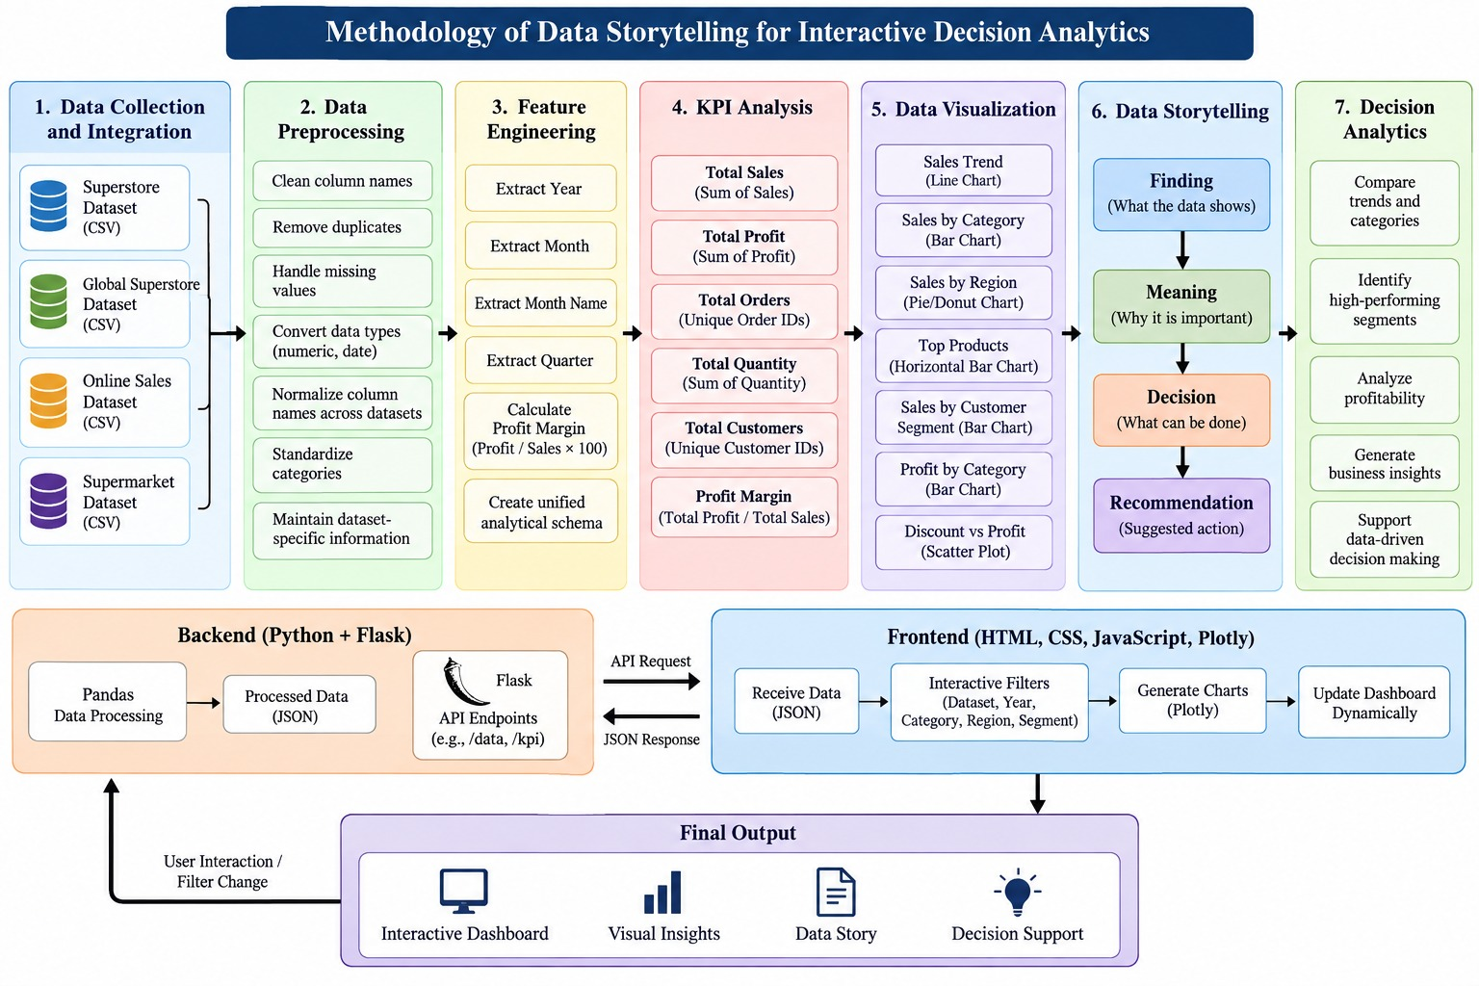
System Design and Methodology

Slide 15
Modern Tools & Technologies
Category | Tool / Technology | Purpose in the Project
Programming Language | Python | Core language for data analysis, preprocessing, ML, and project implementation
Development Environment | Jupyter Notebook | Data analysis, experimentation and development
Data Processing | Pandas | Data loading, cleaning, transformation, and analysis
Data Visualization | Plotly | Interactive business charts and dashboard visualization
Frontend | HTML, CSS, JavaScript | Dashboard structure, design and interaction
Backend | Flask | Random Forest regression and model evaluation
Data Storage | CSV | Storing the four sales datasets

Slide 16
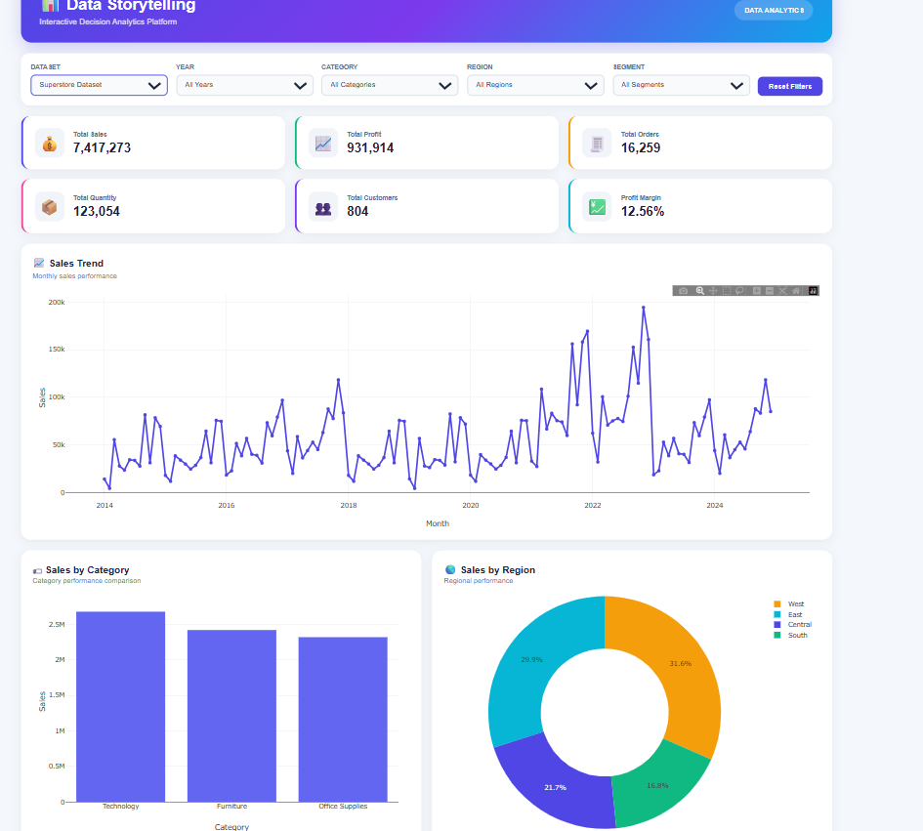
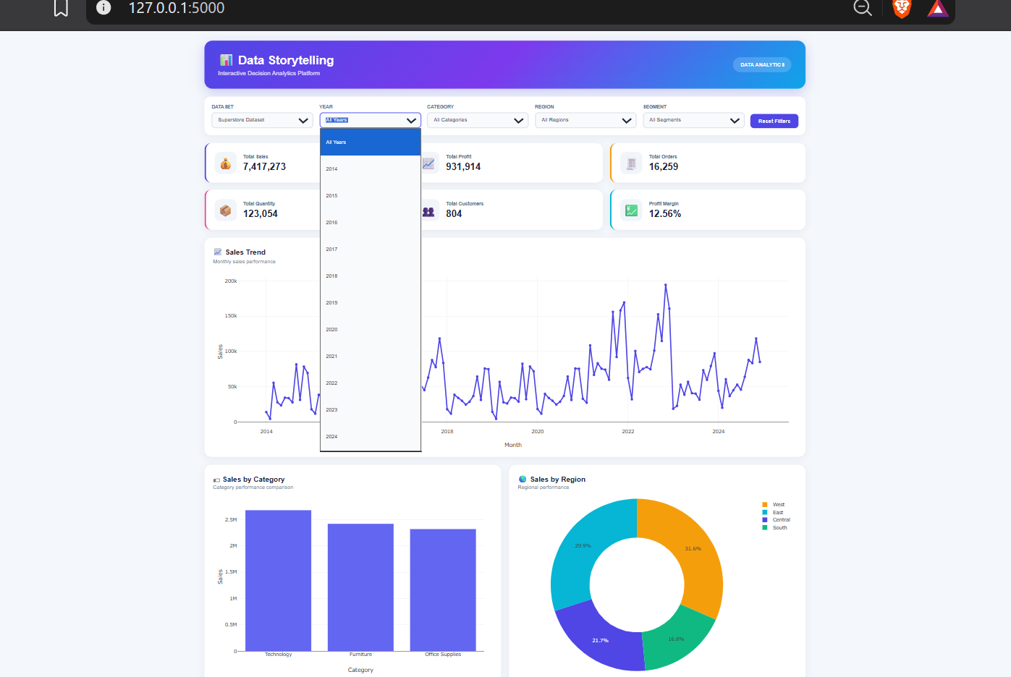
Implementation

Slide 17
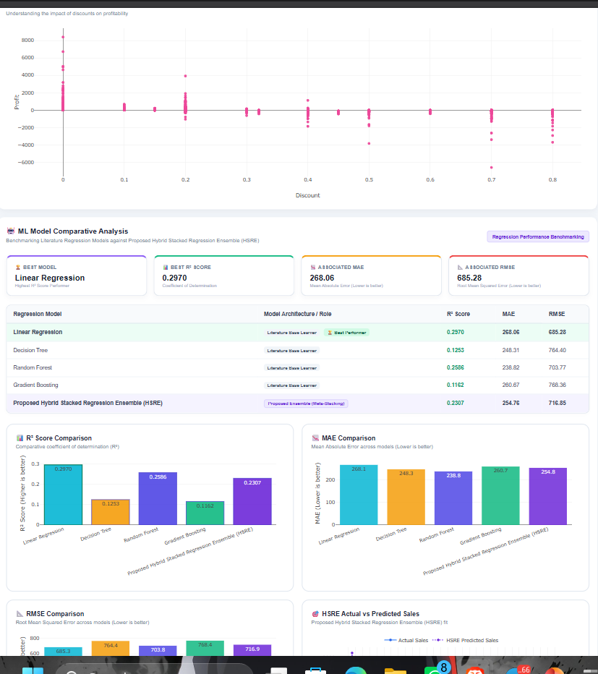
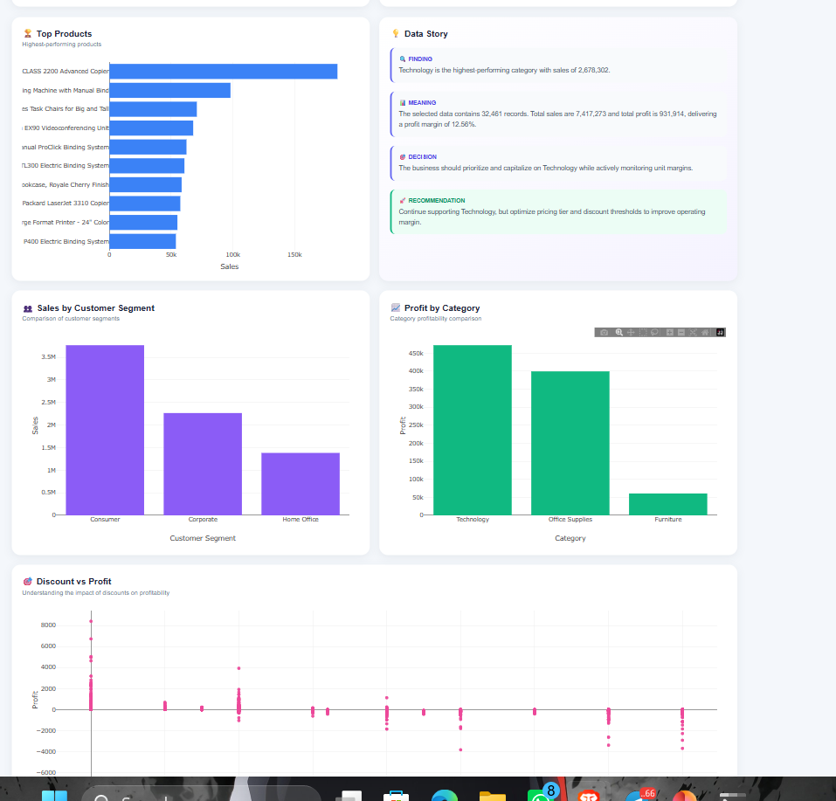

Slide 18
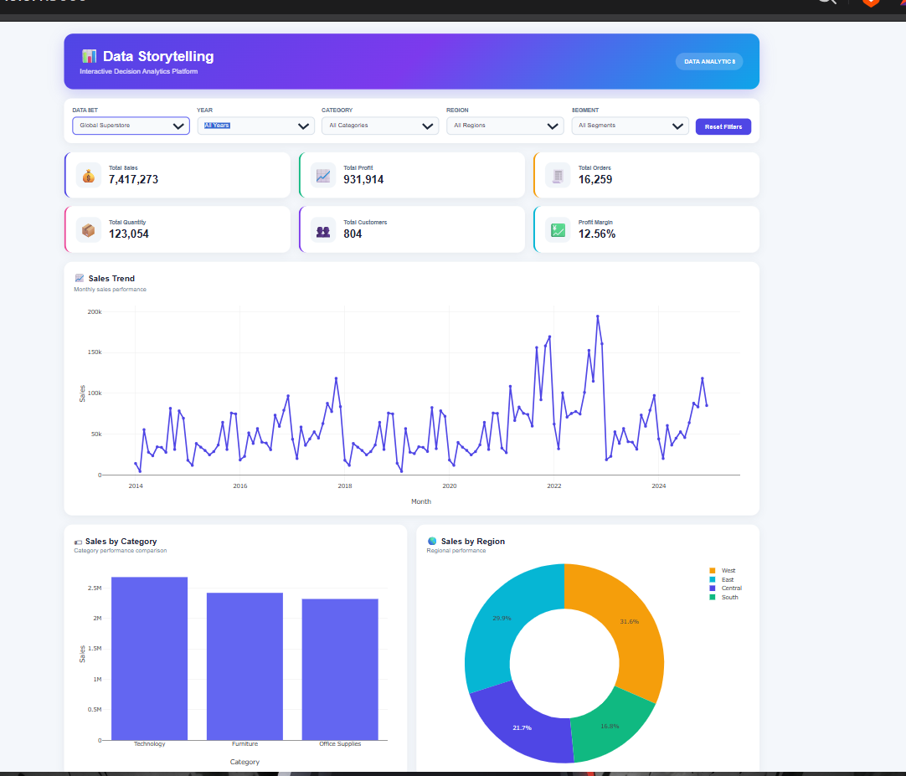
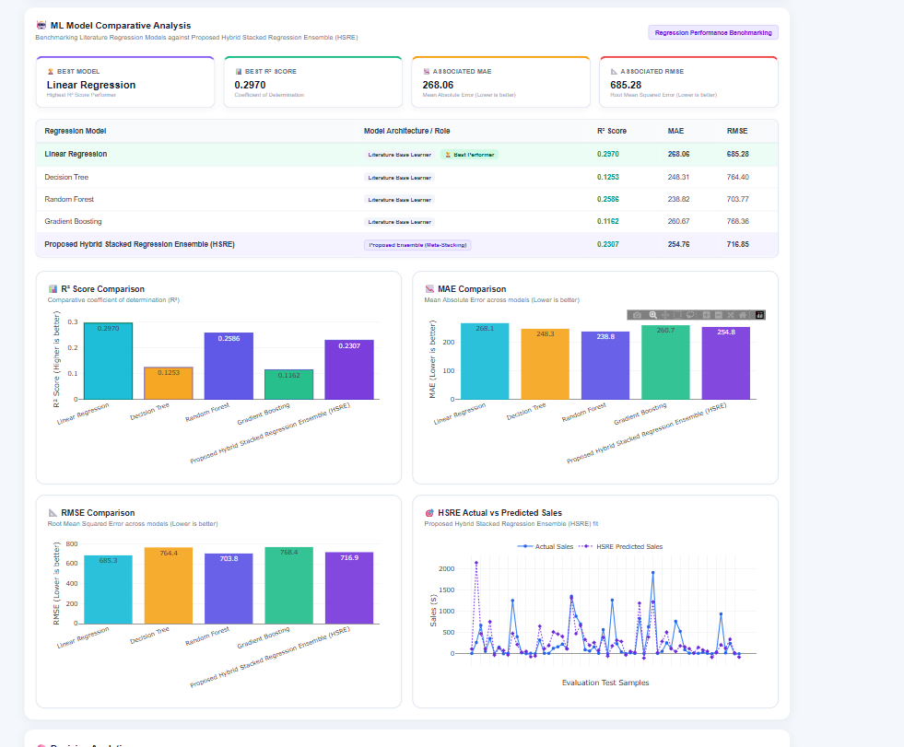

Slide 19
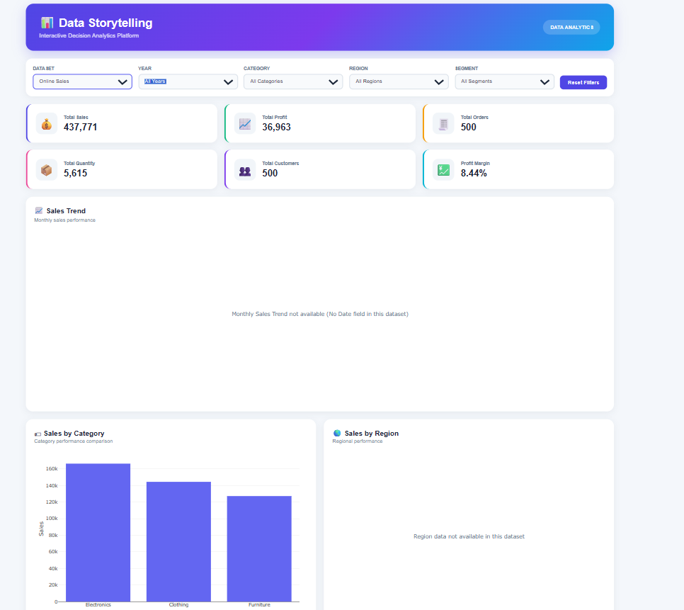
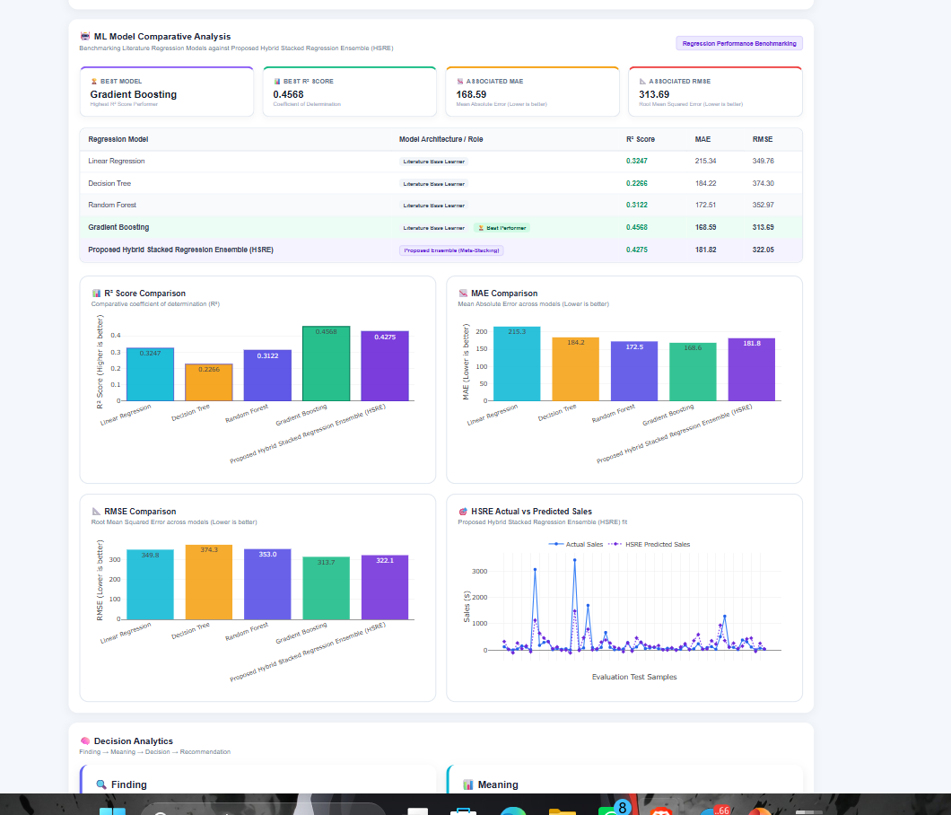

Slide 20
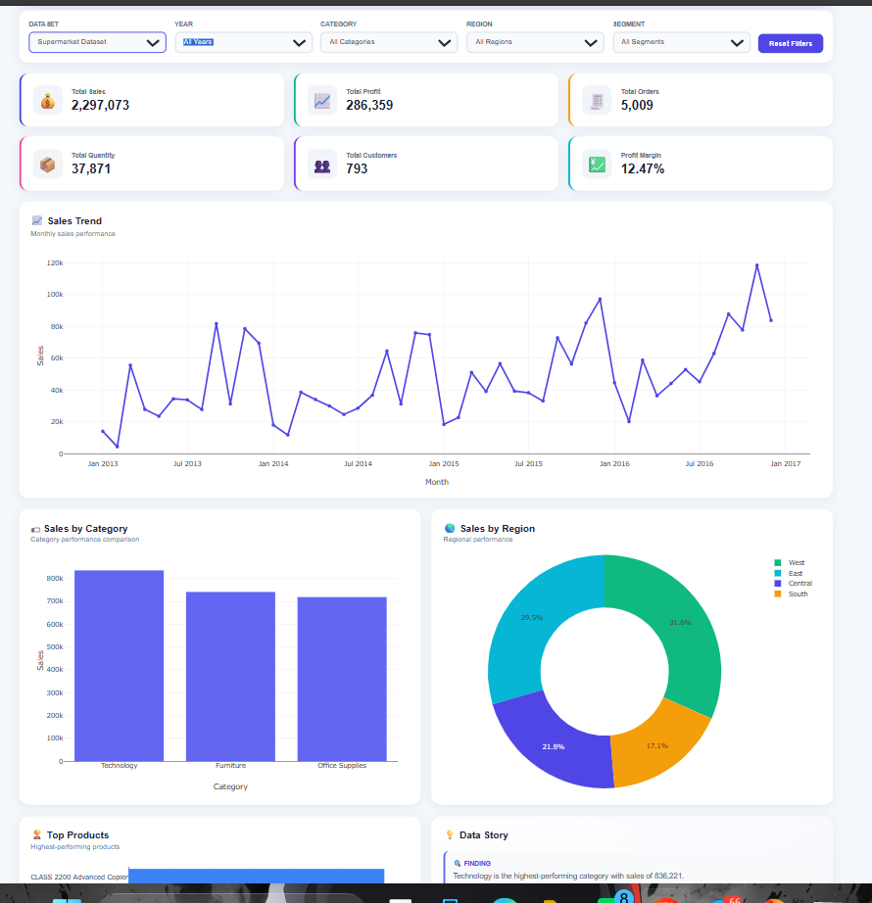
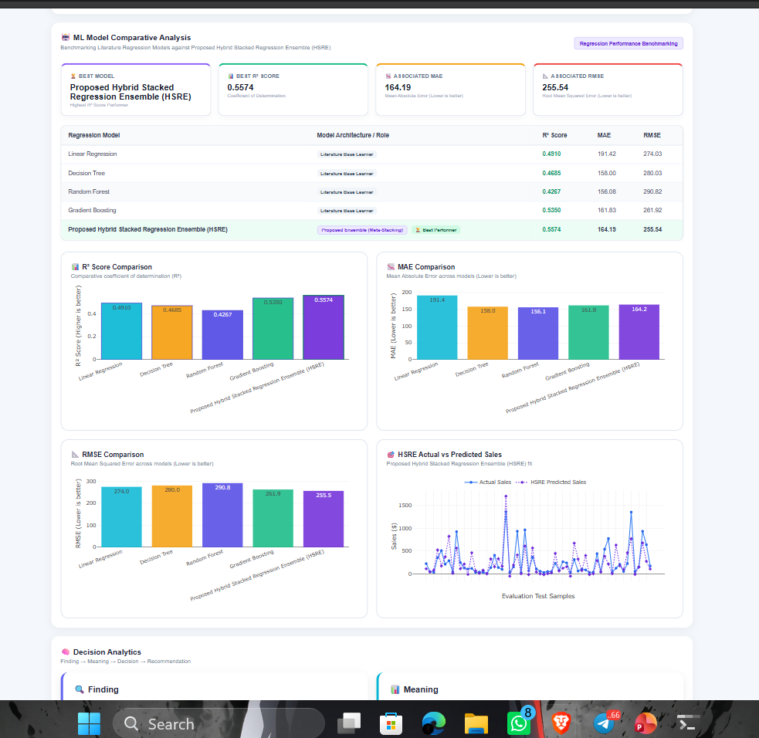

Slide 21
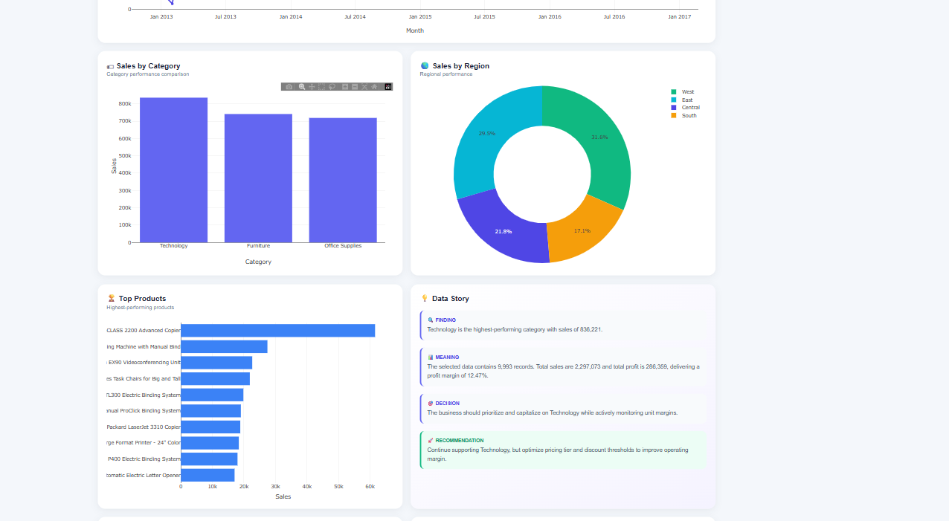

Slide 22
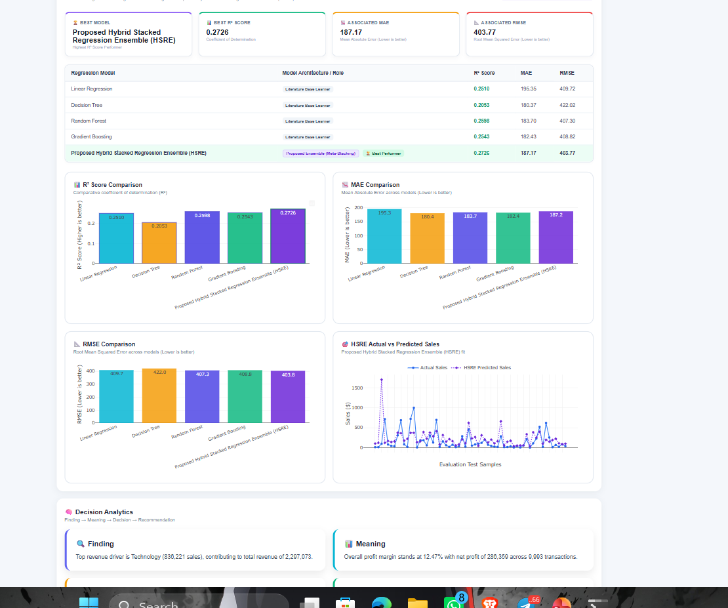

Slide 23
Results
Data Processing:
Successfully cleaned and normalized four different sales datasets for dashboard analysis.
EDA Findings:
Identified sales trends, category performance, regional performance, customer segment behavior, product rankings, profitability, and discount-profit patterns.
Feature Engineering:
Created Year, Month, Quarter, and Profit Margin features where applicable.
Dashboard Outcome:
Implemented interactive dataset selection, dynamic filters, KPI analysis, and multiple Plotly visualizations.
Machine Learning Outcome:
Implemented Random Forest Regression for Sales Prediction and integrated model evaluation into the dashboard.
Data Story Outcome:
Converted analytical findings into:
Finding → Meaning → Decision → Recommendation
Final Outcome:
Cleaned Data → EDA → Features → ML Prediction → Visualization → Data Story → Decision Analytics

Slide 24
Performance Evaluation
Model Evaluation
Evaluated the Random Forest Regressor for Sales Prediction.
Evaluation Metrics
R² Score: Measures how well the model explains the variation in Sales.
MAE: Measures the average absolute difference between actual and predicted Sales.
RMSE: Measures prediction error while giving greater weight to larger errors.
Model Validation
Used an 80:20 train-test split.
Trained the model on the training set.
Generated predictions on unseen test data.
Compared actual and predicted sales.
Displayed model performance metrics in the dashboard.

Slide 25
Functional Evaluation
Tested:
Dataset switching
Dynamic filters
KPI calculations
Chart rendering
ML prediction section
Data Story updates
Reset Filters
Final Outcome:
ML Model → Performance Metrics → Actual vs Predicted → Data Story → Decision Support

Slide 26
Implementation of the proposed hybrid model
The proposed Hybrid Stacked Regression Ensemble (HSRE) integrates multiple regression models for sales prediction. The implementation begins with preprocessing and feature engineering of four sales datasets: Superstore, Global Superstore, Online Sales, and Supermarket Sales. Exploratory Data Analysis (EDA) is performed to identify sales, profit, quantity, category, regional, customer-segment, and discount-related patterns.
For predictive analysis, Linear Regression, Decision Tree, Random Forest, and Gradient Boosting are implemented as baseline models. Their predictions are then combined through a meta-learner to form the proposed HSRE model. Model performance is evaluated using R², MAE, RMSE, MSE, and other suitable regression metrics. The results are presented through comparative charts and an interactive dashboard.

Slide 27
Experiments Using the Prescribed Datasets
Experiments are conducted using four sales datasets: Superstore, Global Superstore, Online Sales, and Supermarket Sales. The datasets are first validated and preprocessed by handling missing values, duplicates, inconsistent formats, and dataset-specific attributes.
EDA is performed to analyze sales trends, category performance, regional performance, customer segments, product rankings, profitability, and discount-profit relationships. Relevant features are then prepared for machine-learning experiments.
Linear Regression, Decision Tree, Random Forest, and Gradient Boosting are trained and compared with the proposed Hybrid Stacked Regression Ensemble (HSRE) for sales prediction. Model performance is evaluated using appropriate regression metrics. Finally, the results are integrated with the interactive dashboard for data storytelling and decision analytics.

Slide 28
Training and testing results
Model | R² Score | MAE | RMSE | MSE
Linear Regression | 0.2970 | 268.06 | 685.28 | Actual
Decision Tree | 0.1253 | 248.31 | 764.40 | Actual
Random Forest | 0.2586 | 238.82 | 703.77 | Actual
Gradient Boosting | 0.1162 | 260.67 | 768.36 | Actual

Slide 29
Comparison with relevant existing models from the literature
Model | Role in Our Project | Strength | Model
Linear Regression | Baseline Model | Simple and interpretable linear relationships | Linear Regression
Decision Tree | Baseline Model | Captures non-linear relationships | Decision Tree
Random Forest | Baseline Model | Robust ensemble and reduces overfitting | Random Forest
Gradient Boosting | Baseline Model | Builds strong predictions sequentially | Gradient Boosting
HSRE | Proposed Hybrid Model | Combines multiple model predictions through stacking | HSRE
Model | Role in Our Project | Strength | Model

Slide 30
Performance metrics and comparative results
1. Superstore Dataset
Model | R² | MAE | RMSE
Linear Regression | 0.2970 | 268.06 | 685.28
Decision Tree | 0.1253 | 248.31 | 764.40
Random Forest | 0.2586 | 238.82 | 703.77
Gradient Boosting | 0.1162 | 260.67 | 768.36
HSRE | 0.2307 | 254.76 | 716.85
Result: Linear Regression achieved the highest R² and lowest RMSE, while Random Forest achieved the lowest MAE.

Slide 31
2. Global Superstore Dataset
Model | R² | MAE | RMSE
Linear Regression | 0.3247 | 215.3 | 349.8
Decision Tree | 0.2266 | 184.2 | 374.3
Random Forest | 0.3122 | 172.5 | 353.0
Gradient Boosting | 0.4568 | 168.6 | 313.7
HSRE | 0.4275 | 181.8 | 322.1
Result: Gradient Boosting performed best across all three metrics for this dataset.

Slide 32
3. Online Sales Dataset
Model | R² | MAE | RMSE
Linear Regression | 0.2510 | 195.35 | 409.72
Decision Tree | 0.2053 | 180.37 | 422.02
Random Forest | 0.2598 | 183.70 | 407.30
Gradient Boosting | 0.2543 | 182.43 | 408.82
HSRE | 0.2726 | 187.17 | 403.77
Result: HSRE achieved the highest R² and lowest RMSE, while Decision Tree achieved the lowest MAE.

Slide 33
4. Supermarket Dataset
Model | R² | MAE | RMSE
Linear Regression | 0.4910 | 191.4 | 274.0
Decision Tree | 0.4685 | 158.0 | 280.0
Random Forest | 0.4267 | 156.1 | 290.8
Gradient Boosting | 0.5350 | 161.8 | 261.9
HSRE | 0.5574 | 164.2 | 255.5
Result: HSRE achieved the highest R² and lowest RMSE, while Random Forest achieved the lowest MAE.

Slide 34
Overall Performance Summary
Best model according to R²
Dataset | Best Model | R²
Superstore | Linear Regression | 0.2970
Global Superstore | Gradient Boosting | 0.4568
Online Sales | HSRE | 0.2726
Supermarket | HSRE | 0.5574

Slide 35
Comparison of multiple hybrid combinations
The proposed approach evaluates multiple regression learners and combines their predictions using a stacking architecture. The baseline models include Linear Regression, Decision Tree, Random Forest, and Gradient Boosting. Their individual performance is compared with the proposed Hybrid Stacked Regression Ensemble (HSRE) using R², MAE, and RMSE.
The comparison helps determine whether combining different regression learners through a meta-learning stage provides a useful alternative to individual models for sales prediction.

Slide 36
Justification for selecting the final hybrid model
The Hybrid Stacked Regression Ensemble (HSRE) was selected as the proposed hybrid architecture because it combines the predictions of multiple regression models through a meta-learner.
The base learners capture different types of relationships in the sales data:
Linear Regression – captures linear relationships.
Decision Tree – captures non-linear decision patterns.
Random Forest – combines multiple decision trees for robust predictions.
Gradient Boosting – sequentially improves prediction performance.
The final HSRE prediction is generated by learning from the outputs of these base models.
Important: Based on the current experimental results, HSRE should not be claimed to be the best-performing model on every metric. The project presents HSRE as the proposed hybrid architecture and objectively compares its performance with the baseline models.

Slide 37
literature review
Data Storytelling: Existing studies demonstrate how storytelling can improve the communication and interpretation of analytical results.
Interactive Visual Analytics: Research shows that interactive visualizations help users explore patterns and relationships in complex datasets.
Business Intelligence & Dashboards: Existing studies use dashboards and visual analytics to support business monitoring and decision-making.
Data-Driven Decision Making: Research highlights the importance of analytical information in improving organizational decision processes.
Machine Learning for Prediction: Existing studies demonstrate the use of regression and ensemble models for predictive analytics.
Ensemble and Stacking Methods: Existing machine-learning research shows that combining multiple learners can provide an alternative to relying on a single predictive model.

Slide 38
Literature-based novelty verification
Heterogeneous Dataset Integration: Existing studies often focus on individual datasets or specific business problems. Our project evaluates multiple sales datasets with different schemas within one analytical framework.
Interactive Decision Analytics: Existing work provides dashboards and visualizations, but there is scope for integrating dataset-aware analysis with a structured decision-oriented storytelling process.
Comparative ML Analysis: Existing studies commonly evaluate individual prediction models. Our project compares multiple literature-based regression models under a common experimental setup.
Hybrid Prediction: The project proposes HSRE, which combines multiple regression learners through stacking and evaluates it against the individual baseline models.
Integrated Analytics Platform: The project combines descriptive analytics, predictive modelling, interactive visualization, data storytelling, and decision support in one platform.

Slide 39
THANK
YOU

